Slide 1
Office 365 Development
Sepetember 2014

Slide 2
Course Agenda
Deep Dive into Integrating Office 365 APIs with Web Applications
Module 1: Deep Dive into Azure AD with the Office 365 APIs
Module 2: Deep Dive into Office 365 APIs for Calendar, Mail, and Contacts
Module 3: Deep Dive into Office 365 APIs for OneDrive for Business
Module 4: Deep Dive into Office 365 APIs for SharePoint Site services
Module 5: Deep Dive into Office 365 APIs for Yammer services
Module 6: Deep Dive into Office 365 APIs for Office Graph
Module 7: Deep Dive into Office 365 APIs for OneNote services

Slide 3
Deep Dive into Office 365 APIs for Calendar, Mail, and Contacts
Speaker
Speaker

Slide 4

Agenda
Overview
ExchangeClient
File Operations with REST

Slide 5
Overview

Slide 6
Calendar Events

Slide 7
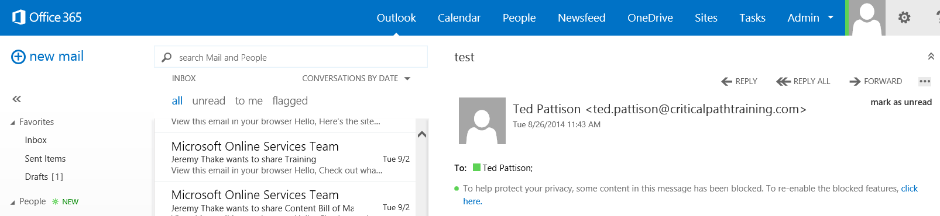
Email Messages

Slide 8
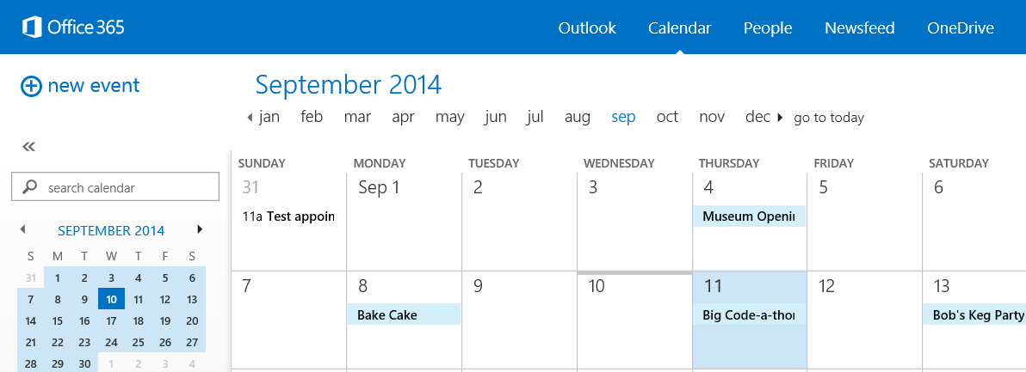
Events
Events are items added to Exhnage

Slide 9
Contacts

Slide 10
APIs
https://outlook.office365.com/ews/odata/Me/Calendar/Events
https://outlook.office365.com/ews/odata/Me/Inbox/Messages
Notes:
_api/Files always targets the “Documents” library in a SharePoint site
For personal sites, this is the OneDrive for Business library

Slide 11
ExchangeClient

Slide 12
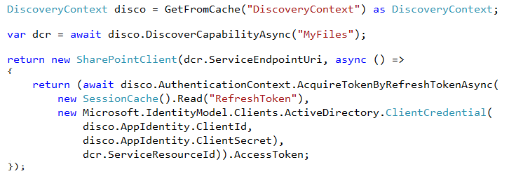
ExchangeClient class
Discovery Service discovers capability
SharePointClient.Files abstracts Files API
Notes:
The discovery service discovers the “MyFiles” capability, which will always try to access the OneDrive for Business library

Slide 13
Retrieving Contacts

Slide 14
Adding a Contact

Slide 15
Deleting a Contact

Slide 16
demo
File operations with the SharePointClient

Slide 17
File Operations with REST

Slide 18
Mail REST API
GET https://outlook.office365.com/ews/odata/Me/RootFolder
GET https://outlook.office365.com/ews/odata/Me/Inbox
GET https://outlook.office365.com/ews/odata/Me/Drafts
GET https://outlook.office365.com/ews/odata/Me/SentItems
GET https://outlook.office365.com/ews/odata/Me/DeletedItems

Slide 19
OneDrive for Business Files REST API
Upload a file to the specified path in OneDrive (pass file in body)
POST /_api/Files/Add(name='folder/filename.docx',overwrite=<bool>)
Delete a file from OneDrive
DELETE /_api/Files('folder/filename.docx')
Get metadata for a folder and its children
GET /_api/Files('folder')?$expand=Children
Get on selected metadata fields back for first 5 files in OneDrive
GET /_api/Files?$select=Name,Id,TimeCreated,Size&$top=5
Use Files API on other document libraries
GET /_api/Lists/GetByTitle('ListTitle')/Files

Slide 20
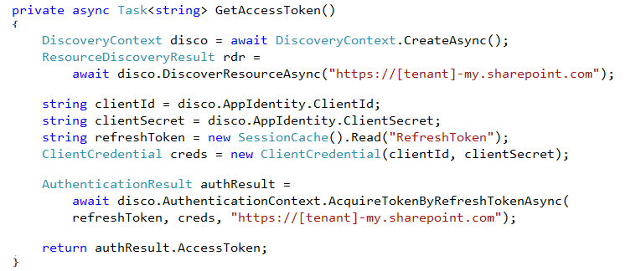
Obtaining an Access Token
Use Discovery Service to get an Access Token

Slide 21
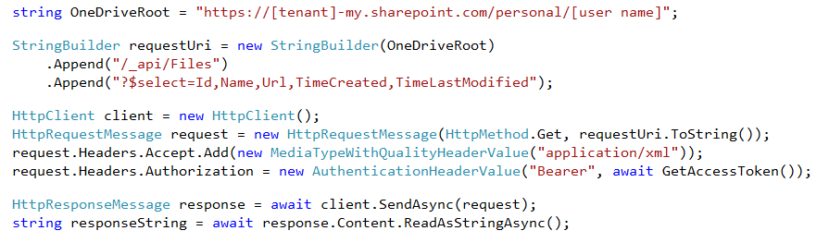
Reading File Metadata
GET Files endpoint
Paging is accomplished post-query using LINQ
Notes:
No support for $skip and $orderby so paging is post-query

Slide 22
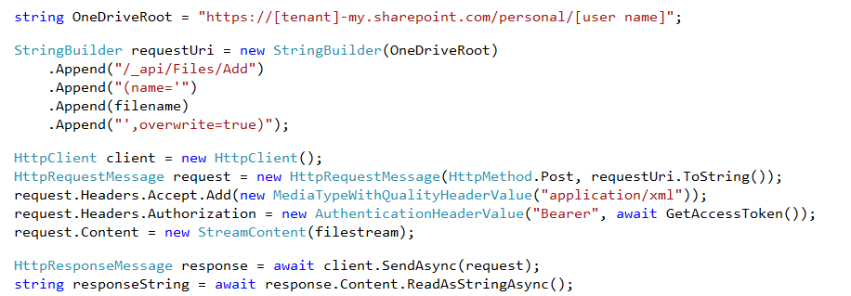
Uploading a new File
POST to Add endpoint
Provide a file name and the file stream

Slide 23
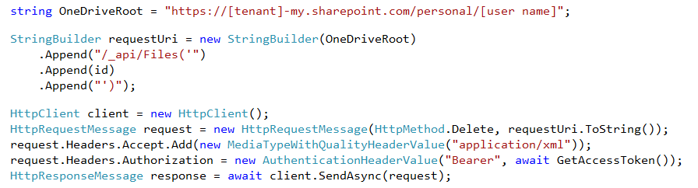
Deleting a File
DELETE the target file ID

Slide 24
demo
File Operations with REST

Slide 25
Summary
Overview
File Operations with SharePointClient
File Operations with REST

Slide 26

© 2012 Microsoft Corporation. All rights reserved. Microsoft, Windows, and other product names are or may be registered trademarks and/or trademarks in the U.S. and/or other countries.
The information herein is for informational purposes only and represents the current view of Microsoft Corporation as of the date of this presentation. Because Microsoft must respond to changing market conditions, it should not be interpreted to be a commitment on the part of Microsoft, and Microsoft cannot guarantee the accuracy of any information provided after the date of this presentation. MICROSOFT MAKES NO WARRANTIES, EXPRESS, IMPLIED OR STATUTORY, AS TO THE INFORMATION IN THIS PRESENTATION.

